Slide 1

Basic Details of the Team and Problem Statement
Ministry/Organization Name/Student Innovation: Gas Authority of India Ltd (GAIL).
PS Code: SK793
Problem Statement Title: Forecasting Natural Gas International Prices using advanced Time-Series Techniques
Team Name: Coding_Nahi_Aati
Team Leader Name: Shivam Tyagi
Institute Code (AISHE): U - 1056
Institute Name: Netaji Subhas University of Technology
Theme Name: Heritage & Culture

Slide 2
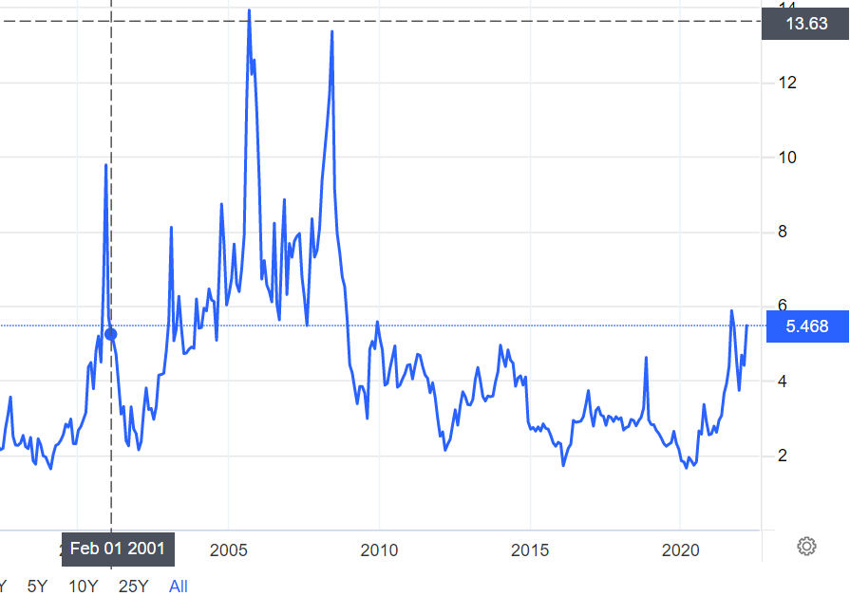
Idea/Approach Details
Feature extraction
Using LSTM(long term short term memory) for long term predictions
Using Regular Models then shifting to Novel Models.
Use Cnn As Feature Extraction
Gaussian Mixture Modelling
Autoencoders
Unforeseen Event Analysis
Sequential Feature Capturing
Interactive Plots
Model Comparisons
Describe your Technology stack here:
Pytorch
Keras
React.js
Node.js/Express.js

Slide 3
Idea/Approach Details
Use Cases
Dependencies / Show stopper
User Interaction
Functionalities/features that user can get
Price Prediction
Analysis
Unforeseen event detection
Model comparison
Interactive plot
Pytorch
TensorFlow
Npm
Node modules
Show Stopper-
Crises when global economy is affected like pandemic, war or market crash.
Site User
UI/UX
Server

Slide 4
Team Member Details
Team Leader Name: Shivam Tyagi
Branch- Btech Stream (COE): Year (III)
Team Member 1 Name: Bhavya Dhingra
Branch- Btech Stream (EE): Year (III):
Team Member 2 Name: Arnav Talwar
Branch (Btech): Stream (ICE): Year (II)
Team Member 3 Name: Hritik Kumar
Branch (Btech): Stream (ICE): Year (II):
Team Member 4 Name: Shreya Singh
Branch (Btech): Stream (COE): Year (II):
Team Member 5 Name: Aditya Bhalla
Branch (Btech): Stream (ICE): Year (II):
Team Mentor 1 Name: Dr. Pinaki Chakraborty
Category (Academic/Industry): Academic | Expertise: software Engg,OS,Design Software,Backend Engg, | Domain Experience (in years):20+
Team Mentor 2 Name: Dr. Mohinder Pal Singh Bhatia
Category (Academic/Industry):Academic | Expertise:software Engg,OS,Design Software,Backend Engg, | Domain Experience (in years): 30+

Slide 5
Important Pointers
Please ensure below pointers are met while
Kindly keep the maximum slides limit to 4 pages
All the topics should be utilized for description of your idea
Try to avoid paragraphs and post your idea in points
Keep your explanation precisely and easy to understand
Idea should be unique and novel. If it has a business potential more weightage will be given.
Apart from this PPT abstract of your idea will be asked separately while submitting
You need to save the file in PDF and upload the same on portal. No PPT, Word Doc or any other format will be supported
You can delete this slide (Important Pointers) when you upload the details of your idea on SIH portal.

